Slide 1
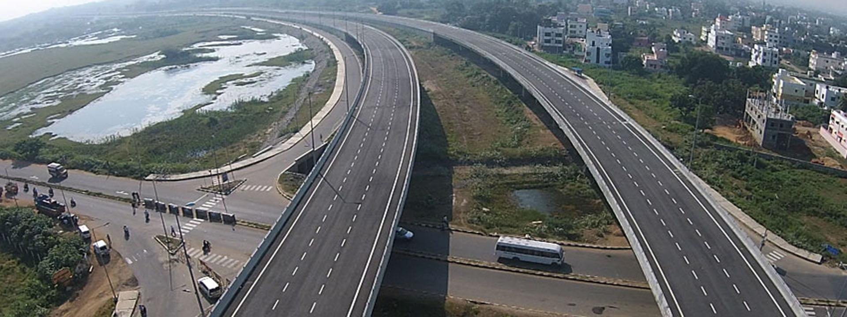
Financial Results
Nine Months Ended December, 2018

Slide 2
Revenue (Standalone) 9 months
- Operating Revenue increased by 20.42% over corresponding nine months ended FY18.
- Operational revenue contributed by Railways is 84%
- Operational revenue contributed by Highways is 12%

Slide 3
Core EBITDA & PAT (Standalone) 9 months
- Core EBITDA margin increased to 7.65% from 6.08% over corresponding period FY18.
- PAT margin increased to 11.36% from 6.73% over corresponding period FY18.

Slide 4
Financial Summary 9 months
(Rs. in Crore)
Particulars | For Nine months |  | Increase/ (Decrease) (%)
 | 2018-19 | 2017-18
Operating Revenue | 2882 | 2393 | 20.42%
Total Revenue | 3073 | 2548 | 20.63%
Core EBITDA | 221 | 145 | 52.41%
Core EBITDA Margin (%) | 7.65 | 6.08 | 1.57%
PBT | 392 | 238 | 64.70%
PAT | 349 | 172 | 102.91%
PAT Margin (%) | 11.36 | 6.73 | 4.63%
EPS (In Rupees) | 37.12 | 17.35
Above figures are on standalone basis. Statutory Auditor has carried out limited review of financials for nine months ended December 2018.

Slide 5
Revenue (Standalone) For Q3
- Operating Revenue increased by 33.82% over corresponding quarter of FY18.

Slide 6
Top Five Projects based on Turnover Contribution in FY 2018-19
Rs. in Crore
Name of the Project | Revised Contract Value | Actual T.O. upto 31.3.18 | Turnover Target for 2018-19 | Turnover Target upto Dec. 2018 | T.O . Achieved in FY 2018-19 (Upto Dec’18) | Cumulative T.O. upto 31.12.2018 | Balance Work Load beyond 31.03.2018
J & K RAIL PROJECT KATRA-QAZIGUND SECTION | 12287.56 | 5248.46 | 1000.00 | 772.09 | 706.23 | 5954.69 | 6171.89
CHATTISGARH-CERL Const. | 1743.13 | 489.90 | 340.00 | 199.00 | 241.25 | 731.15 | 1011.98
HAJIPUR BACHWARA | 584.00 | 73.80 | 250.00 | 133.00 | 146.34 | 220.14 | 363.86
KHULNA MONGLA | 911.16 | 121.66 | 250.00 | 150.91 | 120.70 | 242.36 | 668.80
DAVANAGERE HAVERI HIGHWAY | 916.93 | - | 360.00 | 223.69 | 119.27 | 119.27 | 797.66

Slide 7
Order Book as on 31.12.2018
Segment wise Order Book
(Rs. in Crore)
Sl. | Segment | Amount
1. | Railway | 23,134
2. | Electrical | 416
3. | Buildings | 229
4. | Road & Highways | 2,307
 | Total | 26,086

Slide 8
Thank You

